Slide 1
Force on a Charge in a Magnetic Field

Slide 2
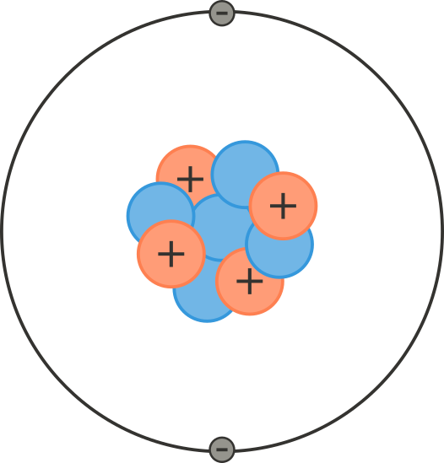
By the end of this lesson, you should be able to:
Describe how the magnitude of the force will change for a charged particle moving in a magnetic field.
Solve problems for the magnitude of the force, the magnetic field or the velocity of a charge.

Slide 3

There are many kinds of charged particles
The most common of which are negatively charged electrons. Electrons are one of the elementary particles which make up all matter.
The idea of electrons was first proposed during the 6th century BCE in ancient India. It was not until 2500 years later in the 19th century that this experimental evidence of electrons was found.

Slide 4
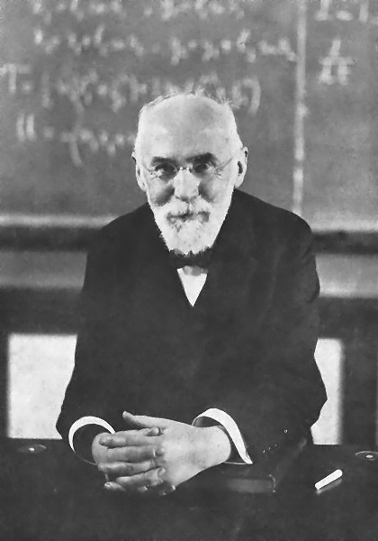
In this lesson we will learn about the Lorentz force, named after Hendrik Lorentz.
Hendrik Lorentz was a Dutch physicist who won the Nobel Prize in Physics in 1902. He contributed to many branches of physics, completing or complementing many important ideas that have become fundamentals of physics, including Einstein’s special theory of relativity.

Slide 5

A charged particle is any particle which carries a net charge.
Both electrons and protons are charged. An electron has a negative charge, and a proton has a positive charge.
Electrons are what you will come across more frequently, as they are the free particles in conductors which allow charge to flow around a circuit. A proton has charge that is equal to an electron's charge, however, it is positive instead of negative.

Slide 6
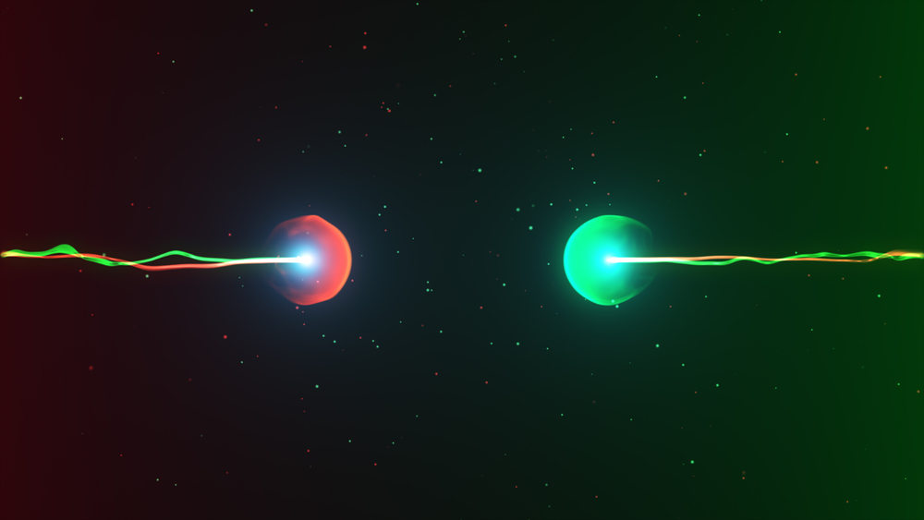
A magnet produces a magnetic field
A magnetic field is essentially a representation of the magnetic force at every point in space around a magnet. While the concept of a magnetic field or a magnetic force can be very abstract, you can quite easily see the result of the magnetic force. For example, if you move a magnet near some magnetic object, like an iron nail, the magnetic force will draw the nail towards the magnet until it sticks to the the magnet.

Slide 7

How can we understand more about magnetic force?
Unfortunately, there’s not a very concrete way to demonstrate a magnetic force, except by doing an experiment like the one mentioned before with the magnet and the nail. However, we can gain a better theoretical understanding of the effects of magnetic fields by looking at how it affects the behaviour of charged particles. The reason we care specifically about charged particles is that electrical charge and magnetism interact in a way that has influenced many modern inventions. In this lesson we will focus on the magnetic force acting on a single charged particle.

Slide 8
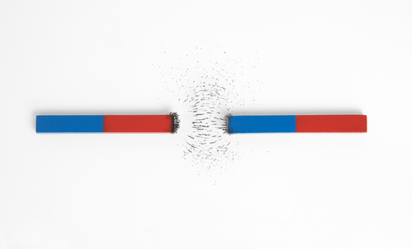
This fundamental interaction between a magnetic field and a charged particle is called the Lorentz force.
What this law says is that a charged particle moving through a magnetic field will have a magnetic force exerted on it. This magnetic force will deflect it from its path through the magnetic field.
The magnetic force on the charged particle is directly proportional to the size of the magnetic field, so a stronger field will deflect a charge more.
Force is also directly proportional to the amount of charge the particle carries, so a larger charge will also be deflected more.

Slide 9


Let’s turn this into a formula.
We know that the size of the force is proportional to the field strength and the charge, but the charge must be moving for the magnetic field to affect it. It turns out if the charge moves faster it will be deflected more by the magnetic field, as the magnetic force will be larger. Thus, the equation for the Lorentz force is as follows:

Slide 10
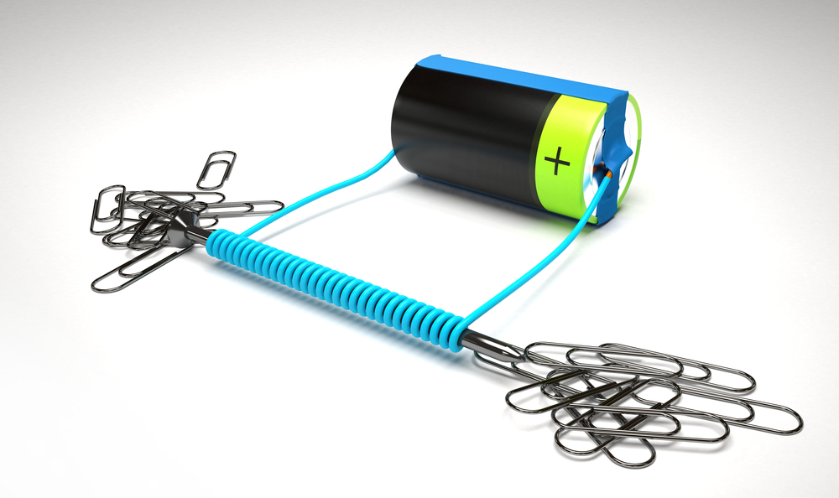
A critical part of the Lorentz force is velocity. We know that there needs to be a charge and a magnetic field—but it is also critical to have a moving charge.
If a charge is stationary, it has a velocity of zero, because velocity is movement through space with time, and therefore experiences no force. This means the force experienced by a charge can change as its velocity changes, but we can’t learn anything about the field from a non-moving charge because the Lorentz force will always be zero for a stationary charge.

Slide 11

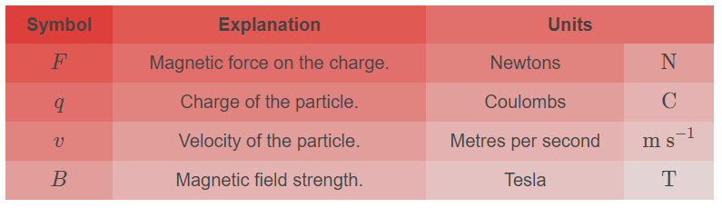
Let’s have a closer look at the components of our new equation.
Some of the components of the Lorentz force equation may be new to you, so we’ll cover what each of them are in the table below:

Slide 12

But there’s an extra symbol in the equation?
The symbol ⊥ is also in our equation, and this stands for “perpendicular”, which means it is the velocity of the particle has to be perpendicular to the magnetic field. If the particle is moving parallel to the magnetic field lines the equation doesn’t work. This means a particle travelling parallel to the magnetic field won't be deflected from its path as there won’t be a magnetic force acting on it.
It is worth noting that the force on the particle will be largest when the particle is travelling perpendicular to the magnetic field if we hold everything else constant.

Slide 13
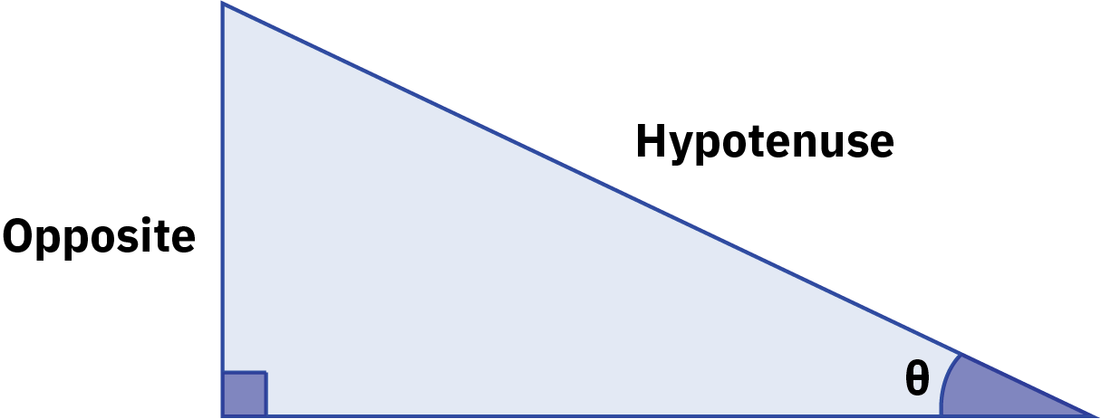
The particle will experience a force as long as it is not parallel to the field lines.
So we can have a particle that isn’t perfectly perpendicular to the magnetic field, it just has to be some angle between parallel and perpendicular, i.e. between 0−90°. The angle of the particle's velocity to the magnetic field lines will reduce the magnitude of the force the particle experiences.
To work this out we need a little trigonometry. To find out how much the angle of velocity will affect the magnitude of the force we use sin(θ), where is the angle between the velocity and the field lines.

Slide 14
What about when the charge is neither parallel nor perpendicular?
For this we need to use some geometry. The angle between the charge’s velocity and the magnetic field lines is given by θ, and we replace the perpendicular sign with sin(θ).
This is the full version of the equation, because when θ=90—i.e. when the charge’s velocity is perpendicular to the magnetic field lines—then sin(θ)=1, so we’re back at our original equation!
Thus, the full version is:
F=qvsin(θ)B

Slide 15
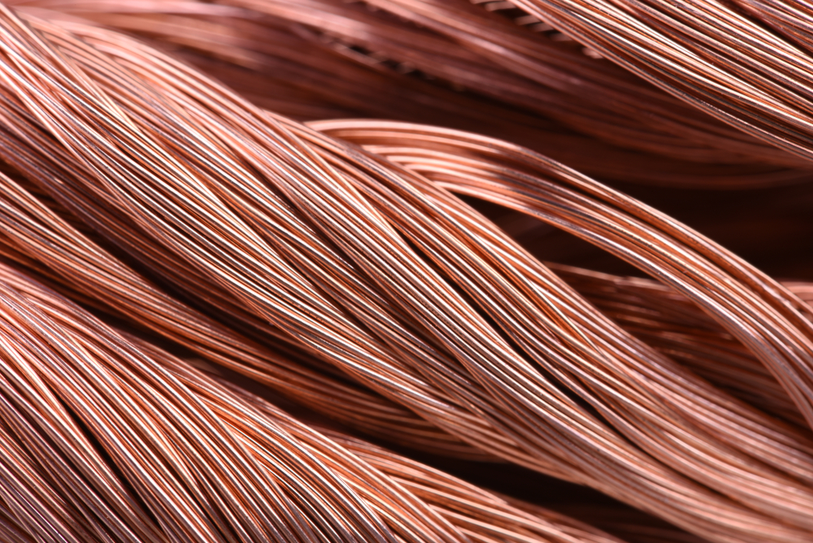
Here is a brief summary of what we have learned so far about the Lorentz force.
A charge moving through a magnetic field will experience a force.
The magnitude of the force will depend on the angle of the charge’s velocity relative to the magnetic field lines—if they are parallel the charge will experience no force.
The magnitude of the force is proportional to both the size of the charge and the strength of the magnetic field.

Slide 16

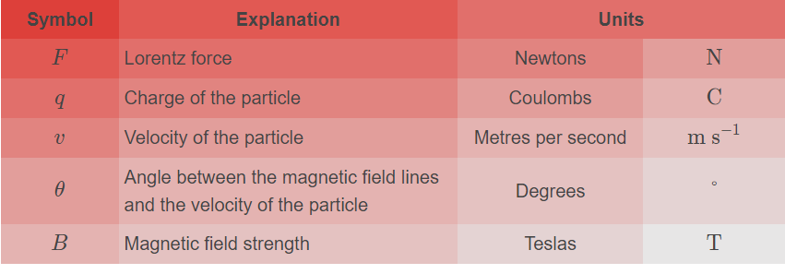
Mathematically, the equation is:

Slide 17
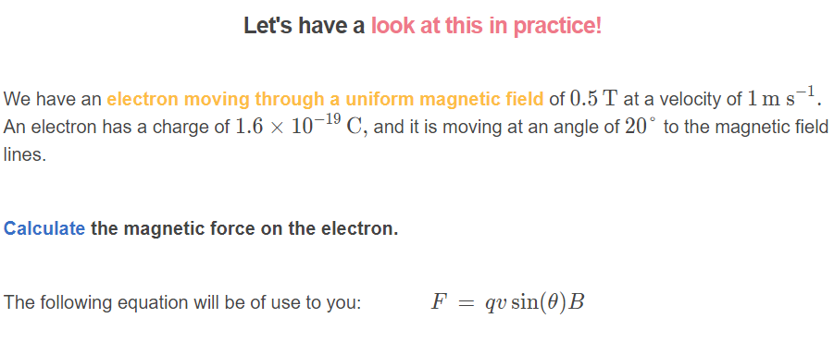

Slide 18
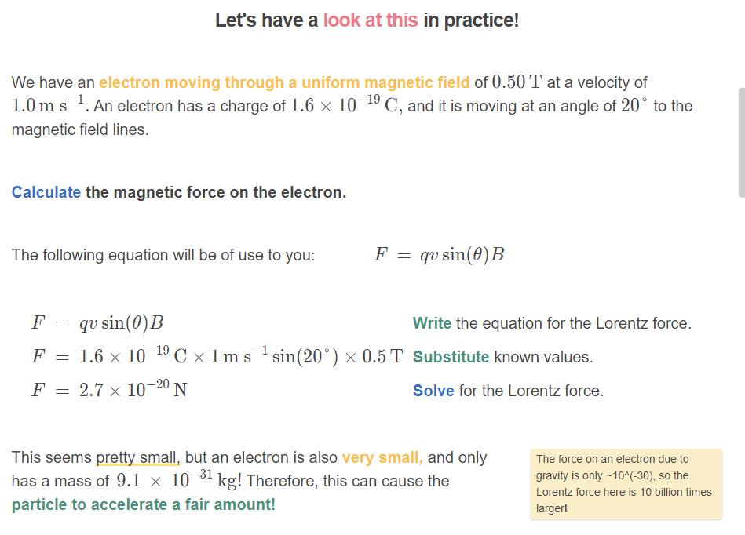

Slide 19
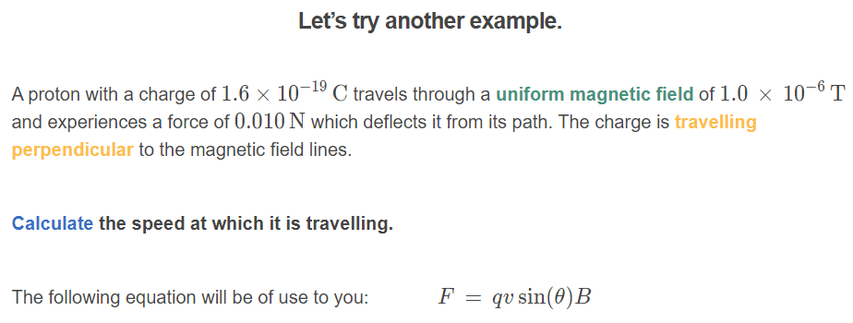
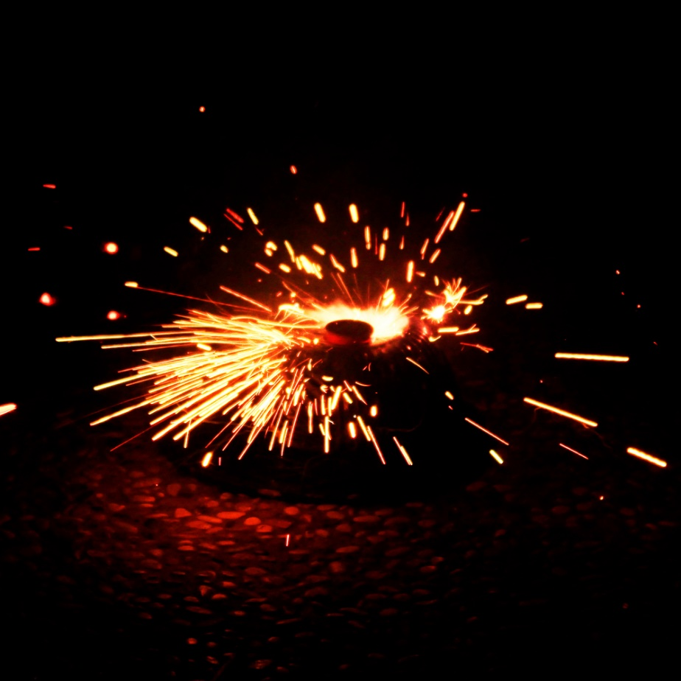

Slide 20
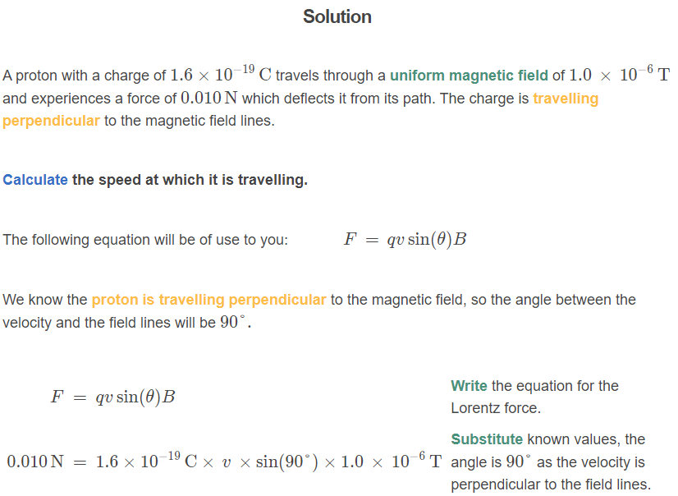

Slide 21
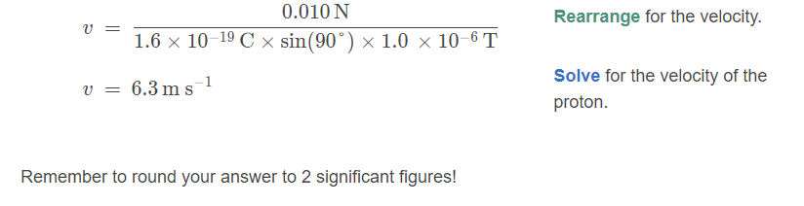

Slide 22
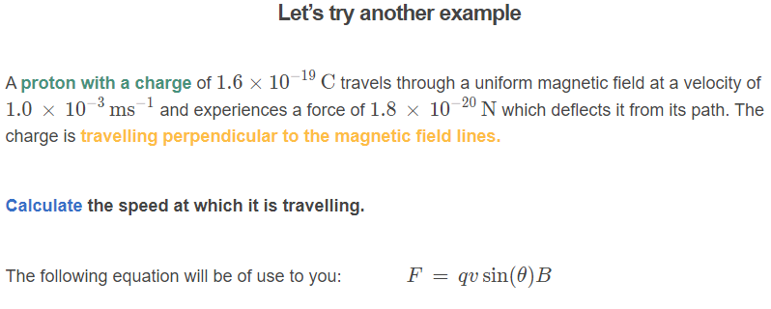


Slide 23
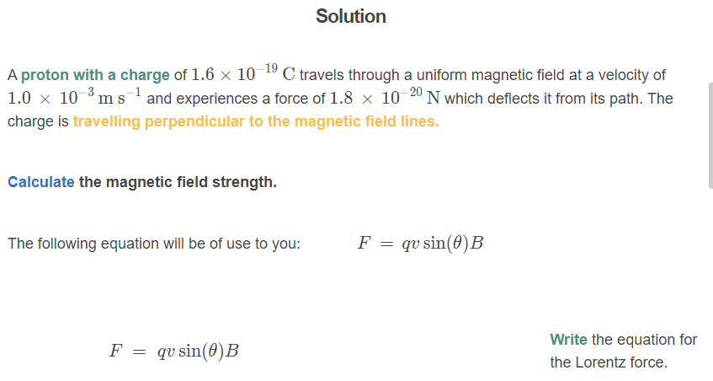

Slide 24
